Slide 1
Police data analysis in Worcester
​
Instructor
Prof. faten alabbas
BY
PRANAY DATA KAVUKUNTLA
LOKESH VANGULA
​

Slide 2
AGENDA
Introduction​
Data cleaning and preparation process
Visualizations
Dashboards
Conclusion

Slide 3
Introduction
This project aims to delve deep into the city's crime statistics, transforming raw data into actionable insights for enhancing public safety.
Utilizing a detailed dataset, we have enhanced the data with additional dimensions like 'Time Range’ , 'Time of Day' and 'Day' to provide a nuanced view of crime patterns. Provided practical visualizations to aid law enforcement and empower the community.

Slide 4





Audience
Law enforcement
Academic and Research Community
General public
City officials
Local Business

Slide 5
Data cleaning and preparation process

Slide 6
Initial Dataset Columns:
Future scope:
Now we have:

Slide 7
Visualizations featuring time range

Slide 8
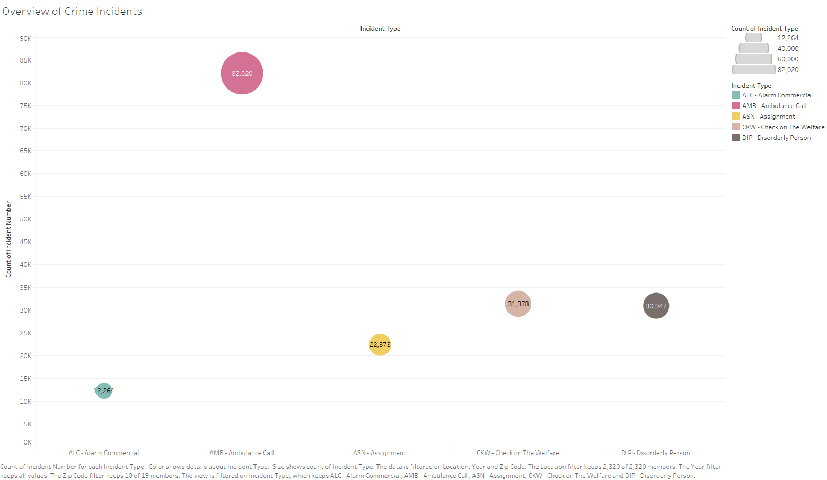

Slide 9
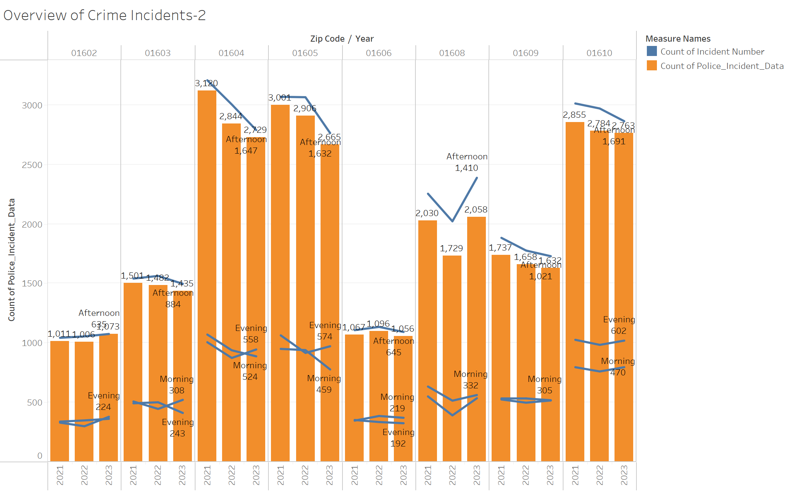

Slide 10
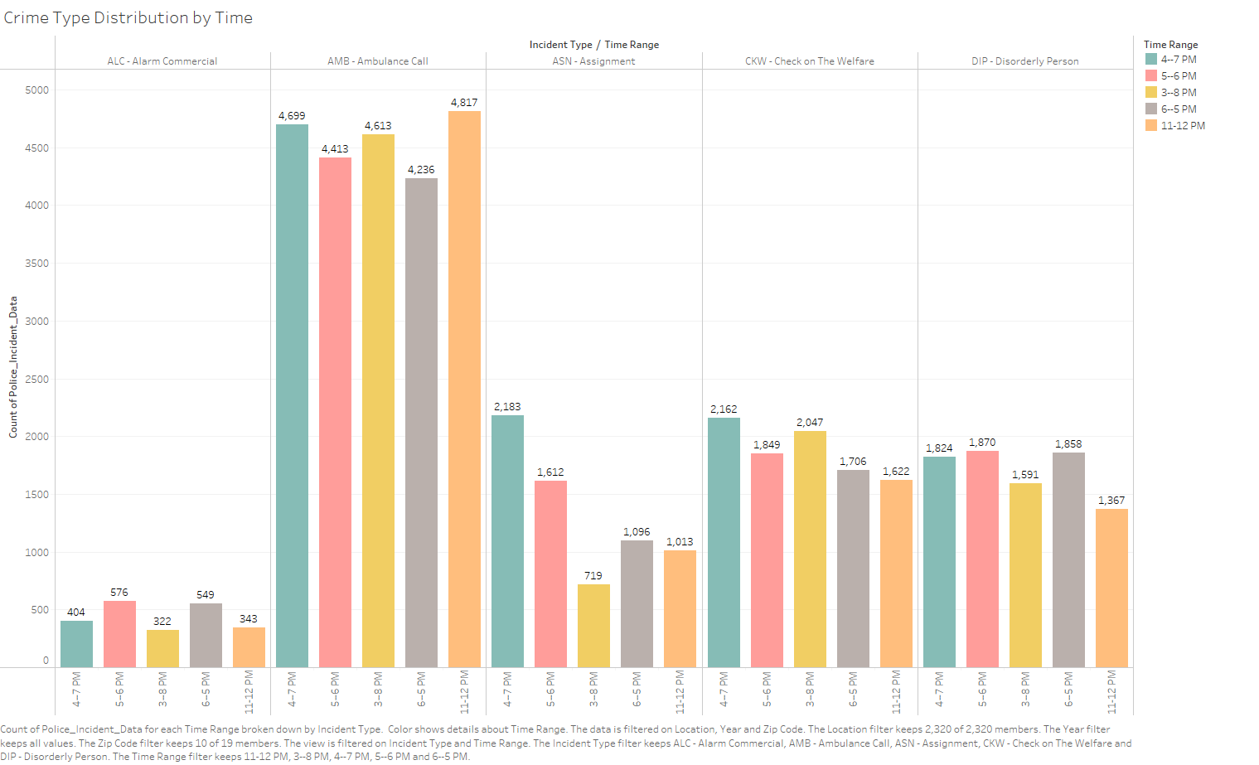

Slide 11
Visualizations featuring time of day

Slide 12
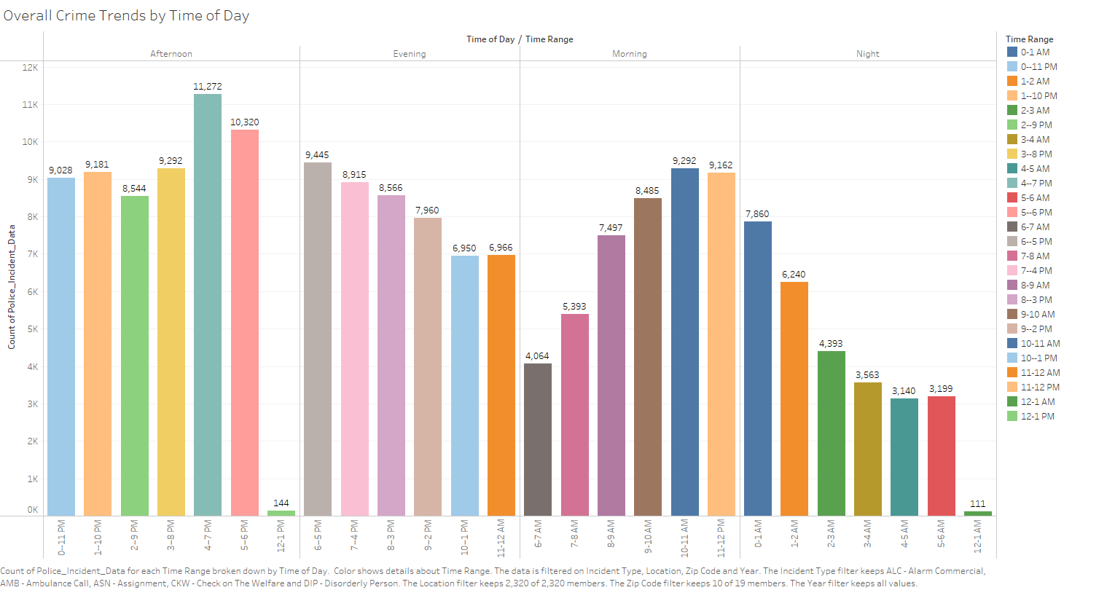

Slide 13
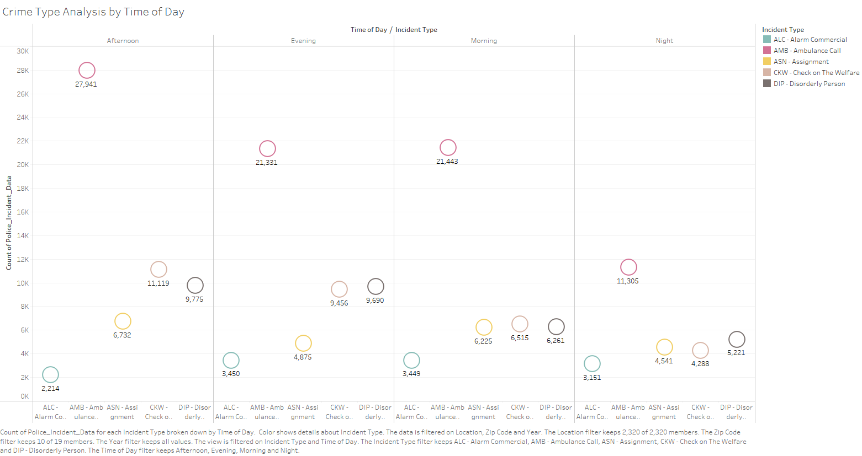

Slide 14
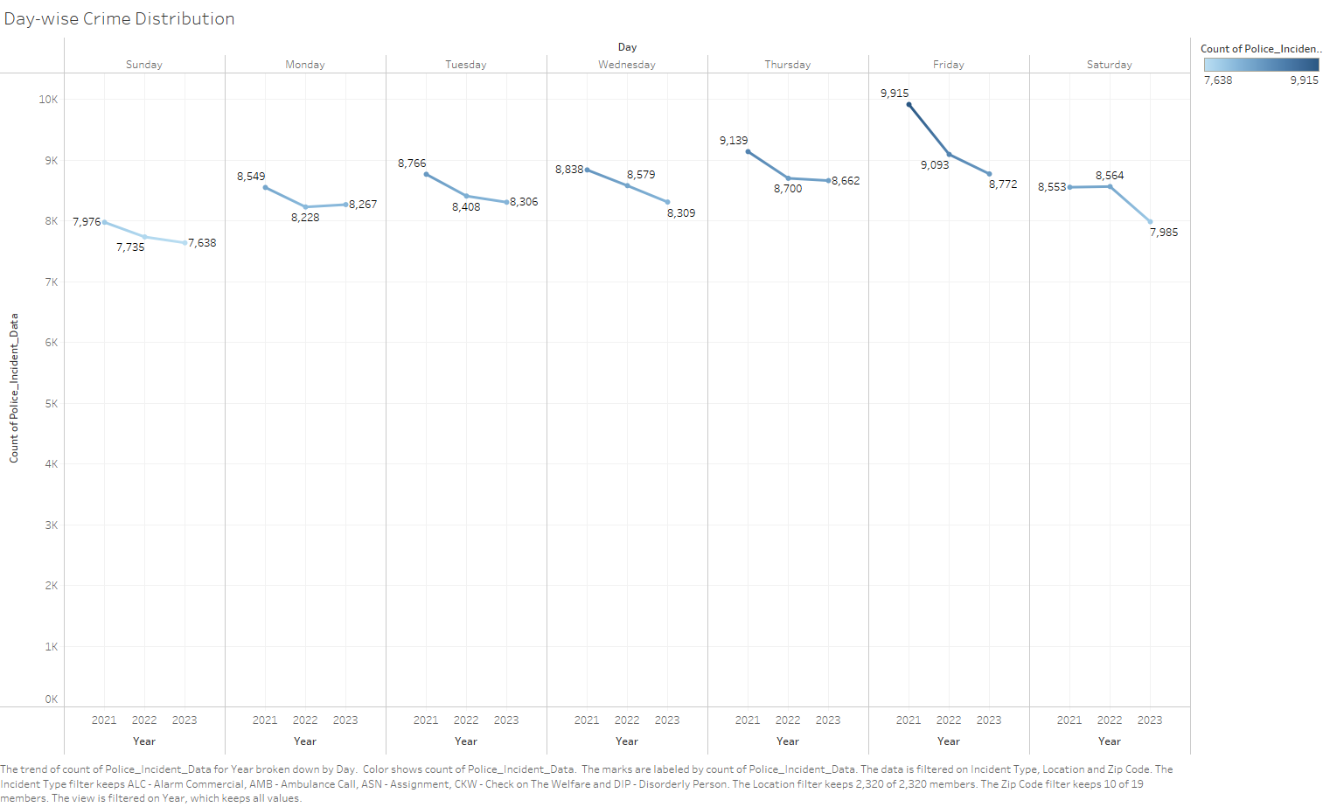

Slide 15
GEOGRAPHICAL
VISUALIZATIONS

Slide 16
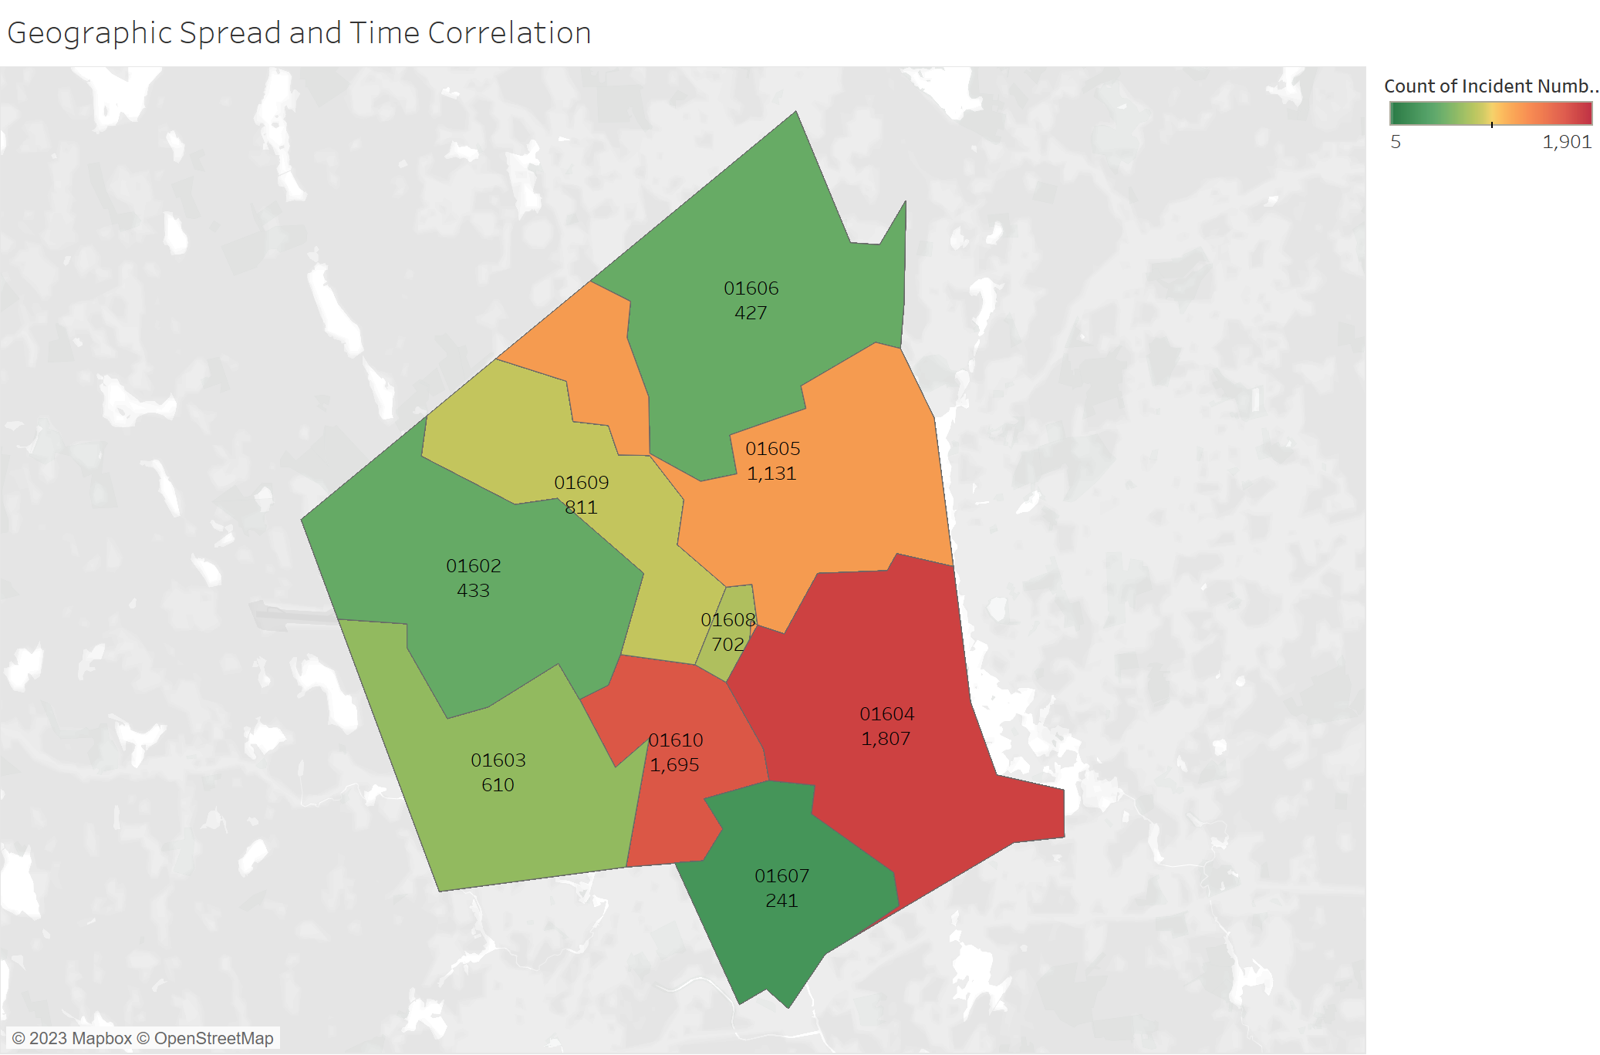

Slide 17
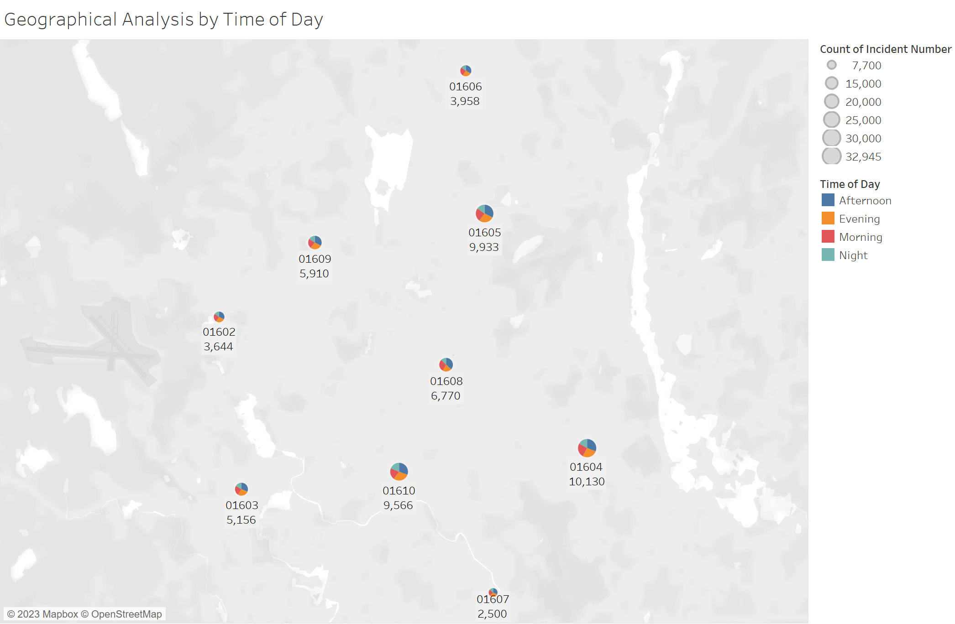

Slide 18
DASHBOARDS
FEATURING
TIME RANGE & TIME OF DAY

Slide 19
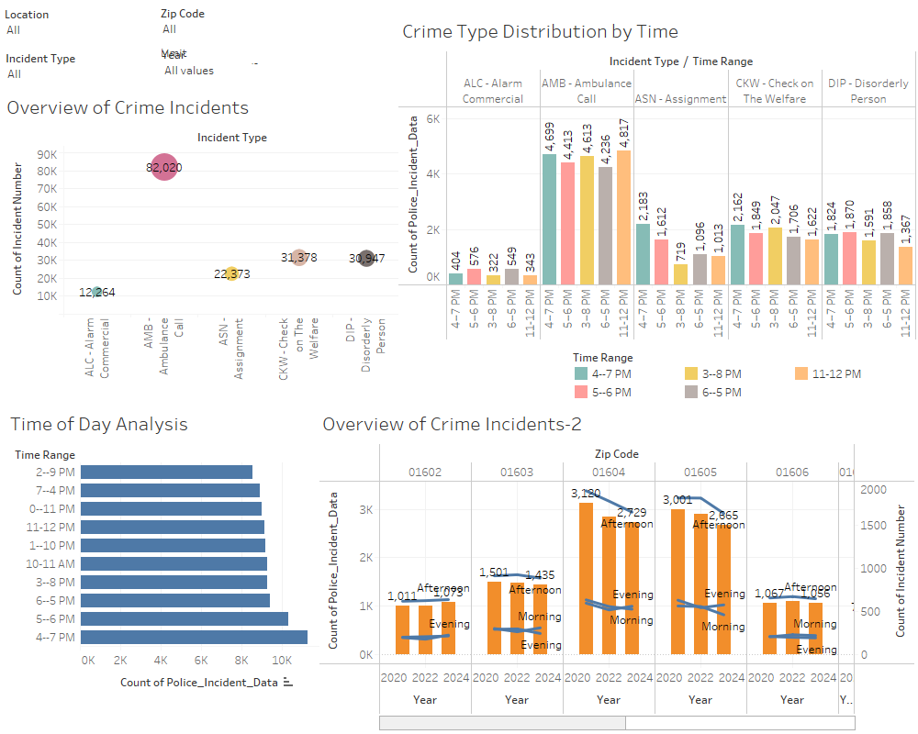

Slide 20
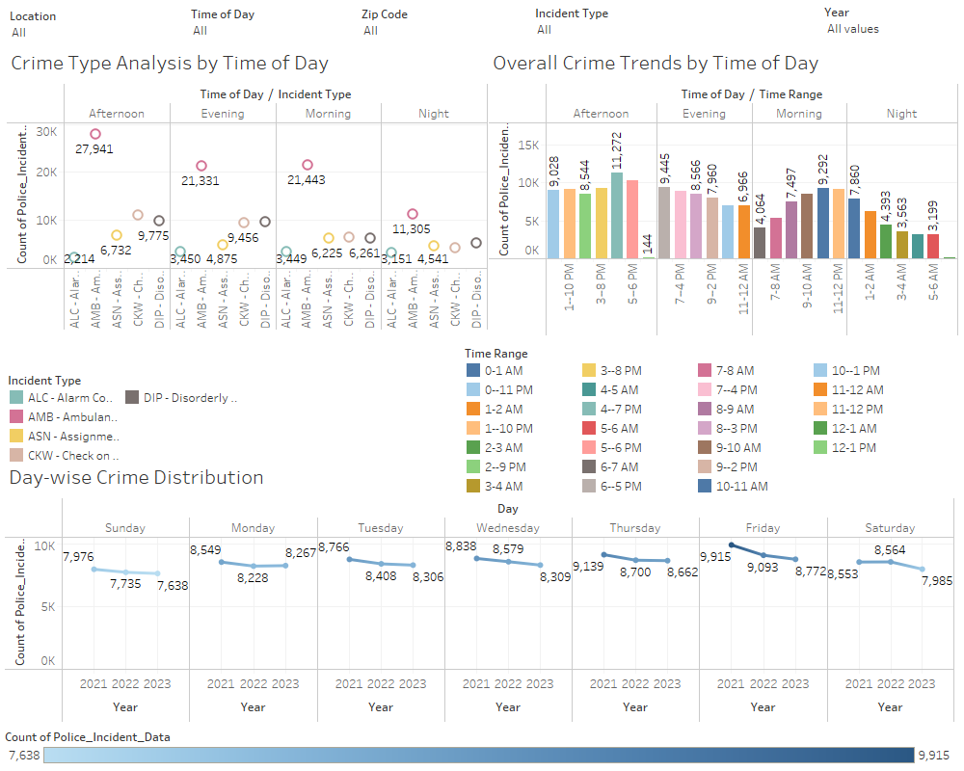

Slide 21
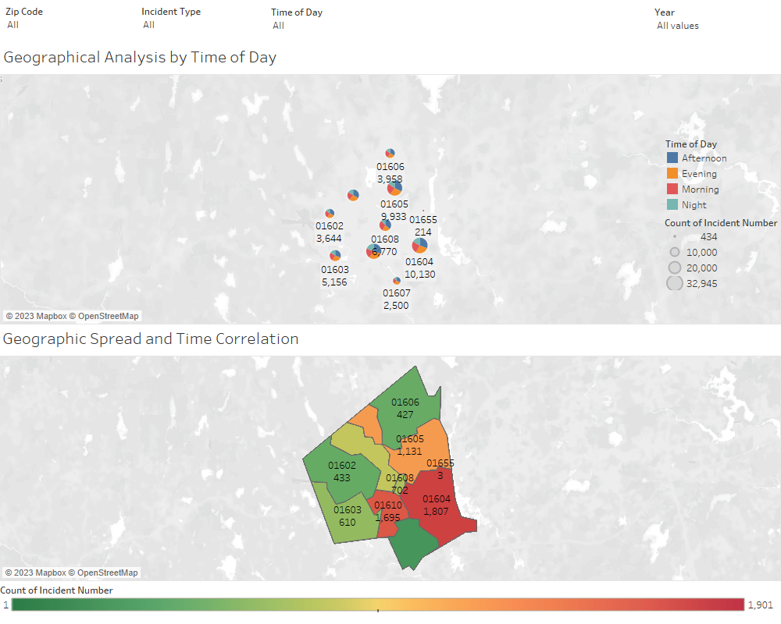

Slide 22
CONCLUSION
The results of our research of Worcester's crime statistics reveal significant patterns in the timing and location of crimes, which can help guide the development of more effective initiatives for public safety. The importance of data-driven techniques in improving the effectiveness of law enforcement and the safety of the community is highlighted by these conclusions. Moving forward, our primary focus will be on consistently enhancing our services and working together to make Worcester a safer place.

Slide 23
THANK YOU

